Slide 1

IBM HR Analytics Employee Attrition & Performance

Slide 2
A Machine Learning Approach to IBM Employee Attrition and Performance
Predicting the Attrition of Valuable Employees…..
In an IT firm, there are many Employee Architectures available. Some IT firms or at particular departments or certain levels follow the chief programmer structure, in which there is a “star” organization around a “chief” position designated to the Engineer who best understands the system requirements.
While, some follow an egoless (democratic) structure, where all the Engineers are at the same level designated for different jobs like Front-End Design, Back-End Coding, Software Testing etc. But, this architecture is not followed by very big or Multi-National Software Giants. But all in all, this is a very successful and working environment-friendly architecture.

Slide 3
3rd Type of architecture is the mixed structure, which is the combination of the above 2 types. This is the mostly followed architecture and very common among software giants.
Likewise, International Business Machine Corporation (IBM) probably follows either egoless or mixed structures. So, for the HR Department, an important responsibility is to measure the attrition of the Employees at specific time-gaps. The factors on which the Employee Attrition depends upon are:
Age of the Employee
Monthly Income
Overtime
Monthly Rate
Distance from Home
Years at Company
and so on…

Slide 4
The Employee Dataset is made available at Kaggle: Predict attrition of your valuable employeeswww.kaggle.com
Description about Dataset:
Uncover the factors that lead to employee attrition and explore important questions such as ‘show me a breakdown of distance from home by job role and attrition’ or ‘compare average monthly income by education and attrition’. This is a fictional data set created by IBM data scientists.
Education
1.'Below College’
2.'College’
3.'Bachelor’
4.'Master’
5.'Doctor'
Environment Satisfaction
1.'Low’
2.'Medium’
3.'High’
4.'Very High

Slide 5
Job Involvement 1.'Low’ 2.'Medium’ 3.'High’ 4.'Very High'
Job Satisfaction
1.'Low’
2.'Medium’
3.'High’
4.'Very High’
Performance Rating
'Low'
'Good'
'Excellent'
'Outstanding'

Slide 6
Import the python libraries:
1. Numpy :
Numpy stands for numerical python.
It is a python package.
It is used for numerical calculation.
It is core library for scientific computing.
It is powerful in n dimensional array objects.
It is installed by pip install numpy.
It provides high performance multi-dimensional array object and tools for working with these arrays.
HOW TO IMPORT NUMPY:
Once numpy is installed, import it in your applications by adding the import keyword:
Import numpy as np
Now , numpy package can be referred to as np instead of numpy

Slide 7
2. Pandas :
Pandas is a Python Library which is useful for Analysis purpose.
Pandas providing high-performance data manipulation and analysis tool using its powerful data structures.
Fast and efficient DataFrame object with default and customized indexing.
Data alignment and integrated handling of missing data.
Reshaping and pivoting of date sets.
Label-based slicing, indexing and sub setting of large data sets.
Columns from a data structure can be deleted or inserted.
Group by data for aggregation and transformations.
High performance merging and joining of data.
Time Series functionality.
HOW TO IMPORT PANDAS :
Once pandas is installed, import it in your applications by adding the import keyword:
Import pandas as pd
Now , pandas package can be referred to as pd instead of pandas

Slide 8
3. Matplotlib:
Matplotlib is one of the most popular python packages used for data visualization.
It is a cross-platform library for making 2D plots from data in arrays.
One of the greatest benefit of visualization is that it allows us visual access to huge amounts of data in easily digestible visuals.
Matplotlib consist of several plots like line , bar, scatter, histogram etc.
Plots helps to understand trends, patterns and to make correlations.
HOW TO IMPORT MATPLOTLIB :
Most of the matplotlib utilities lies under the pyplot submodule, and are usually imported under the plt alias:
Import matplotlib . pyplot as plt
Or
From matplotlib import pyplot as plt
Now the pyplot package can be referred to as plt.

Slide 9
4.Seaborn:
Seaborn is a library mostly used for statistical plotting in Python.
It is built on top of Matplotlib and provides beautiful default styles and color palettes to make statistical plots more attractive.
Lots of themes to work with Matplotlib-style graphics
Ability to visualize both univariate and multivariate data
Support for visualizing varieties of regression model data
Easy plotting of statistical data for time-series analytics
Seamless performance with Pandas, NumPy, and other Python libraries
HOW TO IMPORT SEABORN :
Import the Seaborn module in your code using the following statement:
import seaborn as sns
Now , seaborn package can be referred to as sns instead of seaborn

Slide 10
csv file:
A Comma Separated Values (CSV) file is a plain text file that contains a list of data. These files are often used for exchanging data between different applications. For example, databases and contact managers often support CSV files.
These files may sometimes be called Character Separated Values or Comma Delimited files. They mostly use the comma character to separate (or delimit) data, but sometimes use other characters, like semicolons. The idea is that you can export complex data from one application to a CSV file, and then import the data in that CSV file into another application.
How to load the csv file in jupyter notebook
Hr-Employee.csv. Use this file, ensure you mention the same path correctly for the above saved CSV file during python coding.
import pandas as pd
hr_data=pd. read_csv('C:/your path/’Hr-Employee.csv')

Slide 11
How to get column names in Pandas dataframe
While analyzing the real datasets which are often very huge in size, we might need to get the column names in order to perform some certain operations.
Now let’s try to get the columns name from hr_data dataset.
hr_data.columns
Output:
Index([‘Age’,’Attrition’,’BussinessTravel’,’DailyRate’,’Department’,’DistanceFromHome’,
‘Education’,’EducationField’,……………………………………..’YearSinceLastPermotion’,’YearswithCurrManager’])

Slide 12
Check if any Column's has NA or Missing Values
At the base level, pandas offers two functions to test for missing data, isnull() and not null(). As you may suspect, these are simple functions that return a Boolean value indicating whether the passed in argument value is in fact missing data.
While the isnull() method is useful, sometimes we may wish to evaluate whether any value is missing in a dataset.
hr_data.isnull().any()
Check how many null values present in this dataset or not. In this dataset no any null value is present in each and every columns.
hr_data.isnull().sum()

Slide 13
Shape of dataset
In the Hr.-Employee dataset 1470 rows and 35 columns.
Pandas .shape are used to return the shape of dataset.
hr_data.shape
It return the numbers of rows and columns from the dataset
Data type of Columns
Check the data types of each and every columns by using
Hr_data.dtypes
In this dataset two types of data is shown int and object. Which columns have a numerical data is int datatype and character data show the object type of data

Slide 14
Check the unique value
Pandas library in python easily let you find the unique values.
Use the .nunique function we get the numbers of unique values from the dataset.
hr_data.nunique()
Showing Basics Statistics:
To get the overview of the values each columns contains. You can do this with .describe().
hr_data.describe()
.describe() only analyses numeric columns by default, but you can provide other data types if you use the include parameter.

Slide 15
Kurtosis
Hr_data.kurtosis() function calculate the kurtosis of a data set.
Kurtosis describes the peakedness of the distribution.
If the distribution is tall and thin it is called a leptokurtic distribution. Values in a leptokurtic distribution are near the mean or at the extremes.
A flat distribution where the values are moderately spread out (i.e., unlike leptokurtic) is called platykurtic distribution.
A distribution whose shape is in between a leptokurtic distribution and a platykurtic distribution is called a mesokurtic distribution. A mesokurtic distribution looks more close to a normal distribution.

Slide 16
Skewness
Pandas has a method skew() that computes the skewness of the data present in a given axis of the DataFrame object.
In a normal distribution, the mean divides the curve symmetrically into two equal parts at the median and the value of skewness is zero.
When a distribution is asymmetrical the tail of the distribution is skewed to one side-to the right or to the left.
When the value of the skewness is negative, the tail of the distribution is longer towards the left hand side of the curve.
When the value of the skewness is positive, the tail of the distribution is longer towards the right hand side of the curve.

Slide 17
find all the categorical columns from the dataset
cat_list = []
for variable in hr_data.columns:
if hr_data[variable].dtype== object:
cat_list.ap
pend(variable)
print("Categorical Variables : ", cat_list, '\n')

Slide 18
find all the numerical columns from the dataset
num_list = [].
for variable in hr_data.columns:
if hr_data[variable].dtype!= object:
num_list.append(variable)
print("Numerical Variables : ",num_list, '\n')

Slide 19
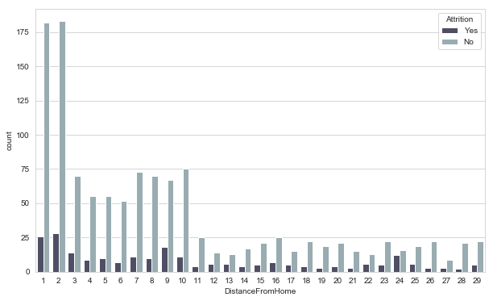
Exploratory Data Analysis
Find patterns in data through data visualization. Reveal hidden secrets of the data through graphs, analysis and charts.
Visualize the number of employee that stayed and left the company by distance from home.

Slide 20
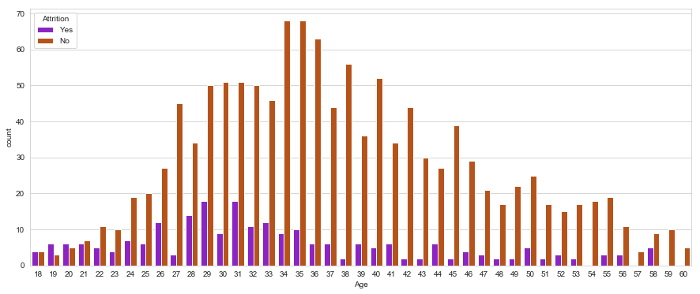
Visualize the number of employee that stayed and left the company by age
In this visualiztion, most of the people whose have a age 34, 35, 36 that people not left the job and on the 50 and 60 ,69 people not left the job . But at the age of 29 and 31 , 19 people lfet the job

Slide 21
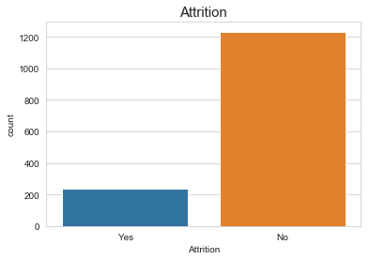
Visualize the number of employees that stayed and left the company
In this graph above the 1200 is show the attrition no and above the 200 is show the attrition yes. It means people most of the employee not attrition the job. 0 means yes and 1 means no

Slide 22
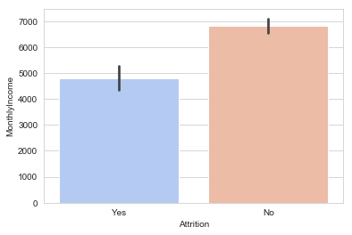
Visualize the number of employees that stayed and left the company by monthly income
This bar chart show that whose employee have a monthly income above the 7000 that employee not left the company and whose have a salary is 5000 or 5500 that employee left the company. It means that monthly income impact the employee they leave the company or not.

Slide 23
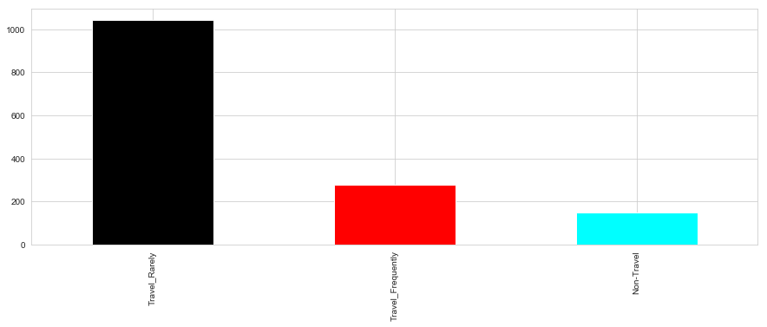
Visualize how many employee travel_rarely, frequently travel and not travel from home to company
Most of the employees are travel_rarely from home to company and 20% employees are travel frequently and the 10 % employees are not travel from home to company.

Slide 24
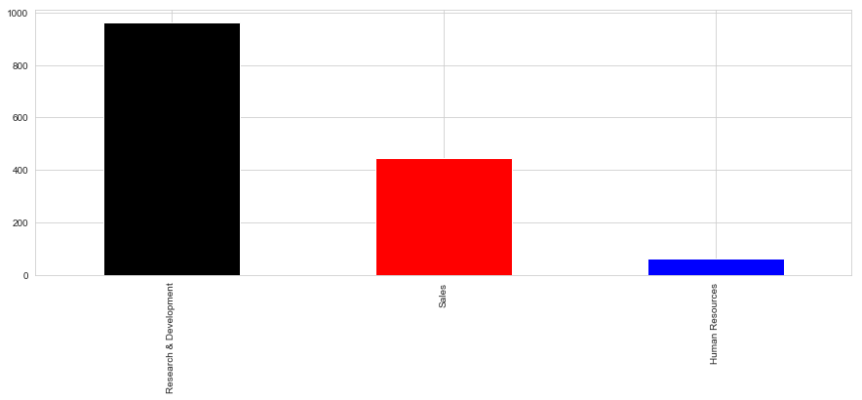
Visualize how many employees are work in sales ,research and development and human resource department
In this show that 80% of the employees are working in the Research & Development department,30% employees are working in the Sales department and the 10% employees are working in the Human Resource department.

Slide 25
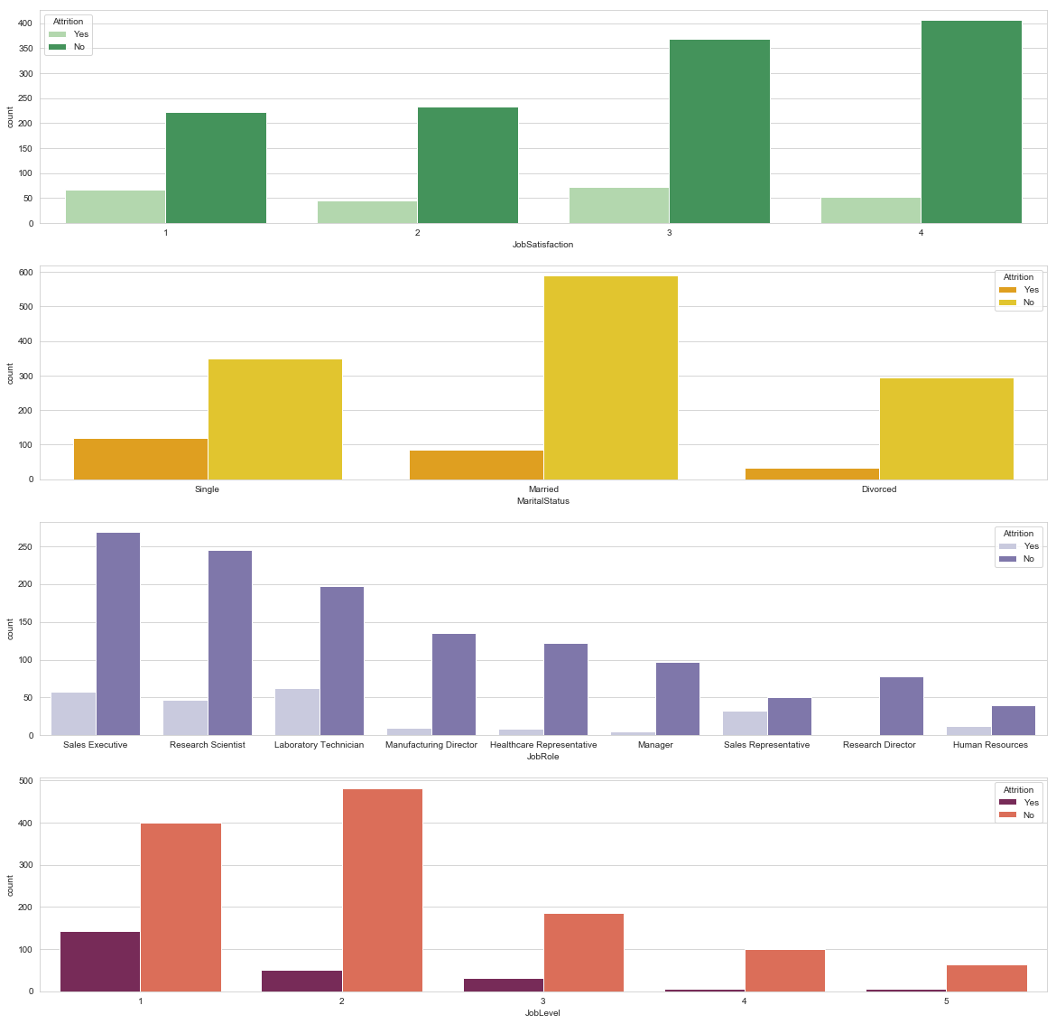
Visualize the Attrition with jobsatisfaction, marital status, job role, job level

Slide 26
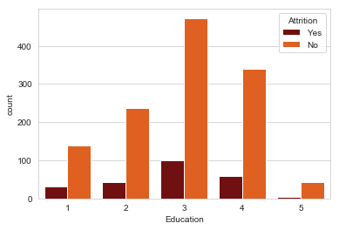
Visualize the number of employee that stayed and left the company by Education

Slide 27
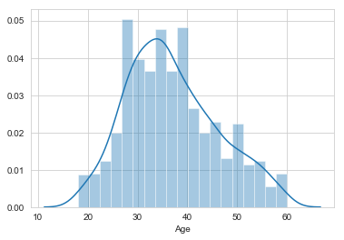
Distplot
Seaborn Distplot. Seaborn distplot lets you show a histogram with a line on it. This can be shown in all kinds of variations. We use seaborn in combination with matplotlib, the Python plotting module. A distplot plots a univariate distribution of observations.
Distplot of Age column

Slide 28
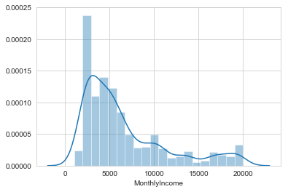
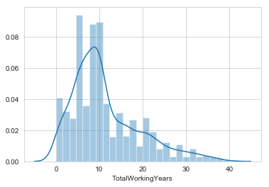
Distplot of MonthlyIncome and TotalWorkingYears column

Slide 29
Replacing Yes with 1 and No with 0 in Attrition Column hr_data['Attrition']=np.where(hr_data['Attrition']=='No', #condition 0, #value if condition is true 1)
Dropping the columns EmployeeCount, StandardHours, EmployeeNumber as these columns does not help in model building.
hr_data=hr_data.drop(['EmployeeCount', 'StandardHours','EmployeeNumber'], axis=1)

Slide 30
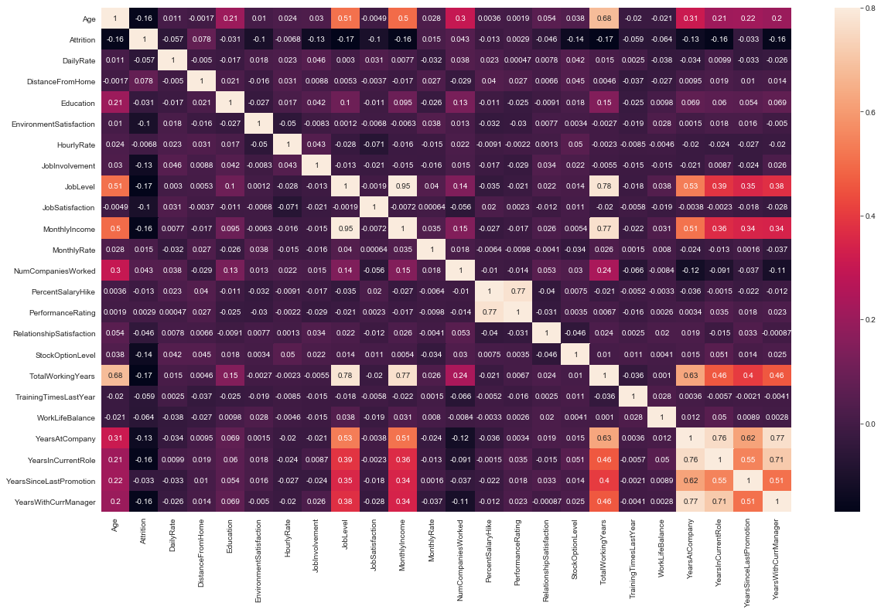
Check the correlation of columns
corr_matrix = hr_data.corr()
f , ax = plt.subplots(figsize=(20,12))
sns.heatmap(corr_matrix,vmax=0.8, annot=True)

Slide 31
Convert the categorical data into the numerical data
numerical_df=hr_data.select_dtypes(include=np.number)
categorical_df=hr_data.select_dtypes(exclude=np.number)
numeric_cols=list(numerical_df.columns)
categorical_cols=list(categorical_df.columns)
Normalize the columns
for n in categorical_cols:
print(pd.crosstab(hr_data['Attrition'],hr_data[n],normalize='columns’))
get the dummies data from the original data
categorical_df_dummies=pd.get_dummies(hr_data[categorical_cols],drop_first=True)
final_df=pd.concat([categorical_df_dummies,numerical_df],axis=1)

Slide 32
Machine Learning
X is the feature and y is target
y=final_df.Attrition
X=final_df.drop(['Attrition'], axis=1)
Splitting Data in Train and Test Set
from sklearn.model_selection import train_test_split
from sklearn.metrics import classification_report,accuracy_score,roc_auc_score,precision_recall_curve,confusion_matrix,precision_score,confusion_matrix
X_train,X_test,y_train,y_test=train_test_split(X,y,test_size=0.2,random_state=100)

Slide 33
Building base model(Predicting that no employee leaves the company) base=np.zeros(1470) print(accuracy_score(base,hr_data.Attrition)) Output- .8387755102040816
Method that applies model on the data and Predict the attrition
def model(mod,model_name,x_tr,y_tr,x_tes,y_te):
mod.fit(x_tr,y_tr)
pred_dt=mod.predict(x_tes)
print(" ",model_name," ")
print("Accuracy ",accuracy_score(pred_dt,y_te))
print("ROC_AUC ",roc_auc_score(pred_dt,y_te))
cm=confusion_matrix(pred_dt,y_te)
print("Confusion Matrix \n",cm)
print(" Classification Report \n",classification_report(pred_dt,y_te))

Slide 34
Logistic Regression: from sklearn.linear_model import LogisticRegression lr=LogisticRegression() model(lr,"Logistic Regression",X_train,y_train,X_test,y_test)
Logistic Regression Accuracy 0.8741496598639455
ROC_AUC 0.8066510695187166
Confusion Matrix [[241 31] [ 6 16]]
Classification Report
precision recall f1-score support
0 0.98 0.89 0.93 272
1 0.34 0.73 0.46 22
micro avg 0.87 0.87 0.87 294
macro avg 0.66 0.81 0.70 294
weighted avg 0.93 0.87 0.89 294

Slide 35
RandomForestClassifier: from sklearn.ensemble import RandomForestClassifier rf=RandomForestClassifier(n_estimators=10,max_depth=4) model(rf,"Random Forest",X_train,y_train,X_test,y_test)
Random Forest Accuracy 0.8469387755102041
ROC_AUC 0.7586805555555555
Confusion Matrix [[245 43] [ 2 4]]
Classification Report
precision recall f1-score support
0 0.99 0.85 0.92 288
1 0.09 0.67 0.15 6
micro avg 0.85 0.85 0.85 294
macro avg 0.54 0.76 0.53 294
weighted avg 0.97 0.85 0.90 294

Slide 36
DecisionTreeClassifier: from sklearn.tree import DecisionTreeClassifier dt=DecisionTreeClassifier(min_samples_leaf=20, max_depth=4) model(dt,"Decision Tree",X_train,y_train,X_test,y_test)
Decision Tree Accuracy 0.8503401360544217
ROC_AUC 0.7186617100371747
Confusion Matrix [[236 33] [ 11 14]]
Classification Report
precision recall f1-score support
0 0.96 0.88 0.91 269
1 0.30 0.56 0.39 25
micro avg 0.85 0.85 0.85 294
macro avg 0.63 0.72 0.65 294
weighted avg 0.90 0.85 0.87 294

